Slide 1


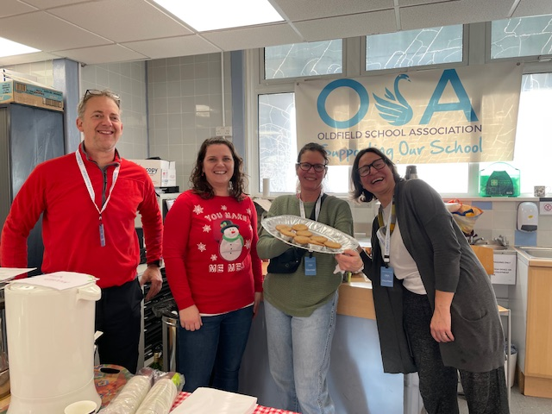
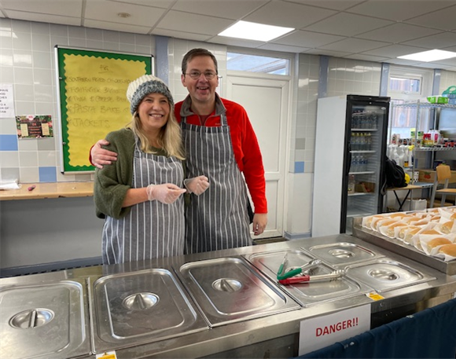
If you would like to help, there are three easy ways to get involved.
1. Support our events, please do come along and say hello!
2. Join our volunteer group, a WhatsApp group of Oldfield parents who are happy to help as and when they can. We simply post upcoming events, see who’s available, and pull together a rota from there.
Please email osa@oldfieldschool.com with your name and mobile number if you’d like to be added to the list.
Welcome to OSA, the PTA at Oldfield School.
We are a small charity run by parents, carers, and staff. We organise and support events at the school to raise money to enhance the wellbeing and education of Oldfield students.
This year we have raised over £10,000 to support projects at the school including: subsidising school trips, resources to support EAL and Thrive activities, Y11 wellbeing workshops, a new mixing desk for the main hall, extra laptops for Product Design, one-to-one mentoring, and amongst the more unusual requests, a new skeleton and torso for the science department!
3. Sign up for easyfundraising by scanning the QR code opposite and completing the sign-up process, naming Oldfield School Association Bath as your nominated charity. Over 8,000 retailers and brands have signed up to easyfundraising - every time you shop online with them, they will donate at no extra cost to you. It’s already raised over £500 for the school!
Parents and carers who have volunteered with us say that OSA has been one of the best ways to be involved in school life and your help really does make a difference.
If you can spare a few hours here and there, or would like to come along to our next meeting to find out more, please drop us a line at osa@oldfieldschool.com

Slide 2
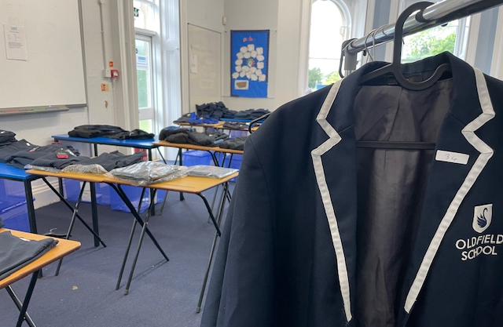
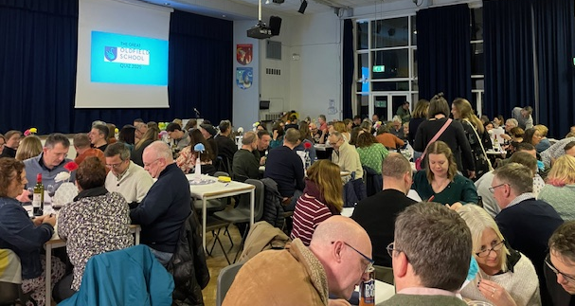
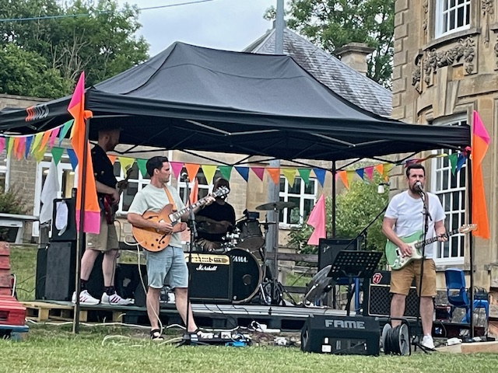
One of our aims is to bring together the school community, which was brilliantly demonstrated by this year’s Quiz Night, which saw 140 parents and staff come together to battle it out. The evening raised over £1,800 for the school.
Pre-loved uniform sales
Every term we hold a pre-loved uniform sale, to help parents with the cost of purchasing uniform and to reduce items going to landfill.
Dates will be posted on the OSA page of the school website. Most sales take place after school, but a couple of times a year the sales are held on Saturdays, to improve access for parents and carers who can’t make the after-school sales.
We are always looking for donations of uniform to keep us stocked up so please consider donating spare items of uniform to OSA. The uniform should be in good condition, washed and ready to sell. Donations can be handed in at reception in a bag labelled OSA at any time throughout the year.
Thank you for your support.
We also ran a new event for the summer term - Olderfest, bringing live music and a festival vibe to Penn field.

