Slide 1




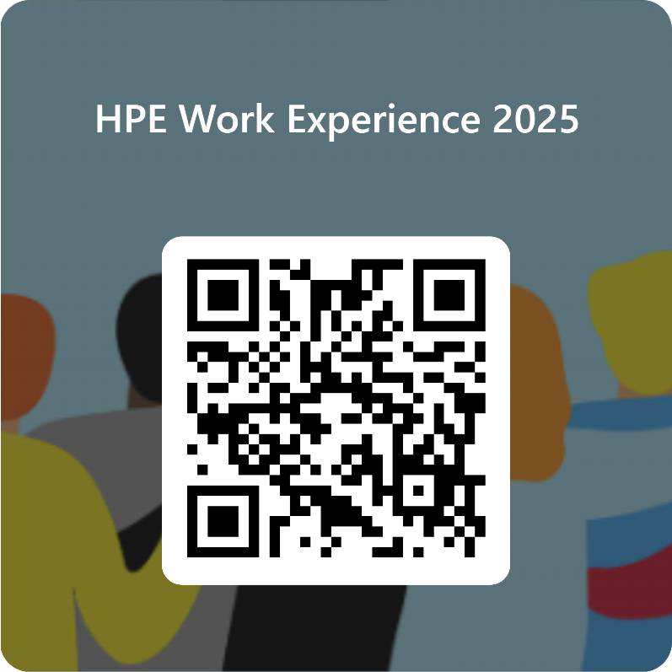
HPE
Work Experience
7th – 10th April 2025
14th – 17th July 2025
10am – 4pm
The Aviva Centre, Stoke Gifford, Bristol BS34 8SW
Calling students in Years 10-12
Join us for a 4 day on site work experience at Hewlett Packard Enterprise (HPE).
You'll develop new skills and experience what its like to be a software developer
Scan QR Code to Apply!

Slide 2

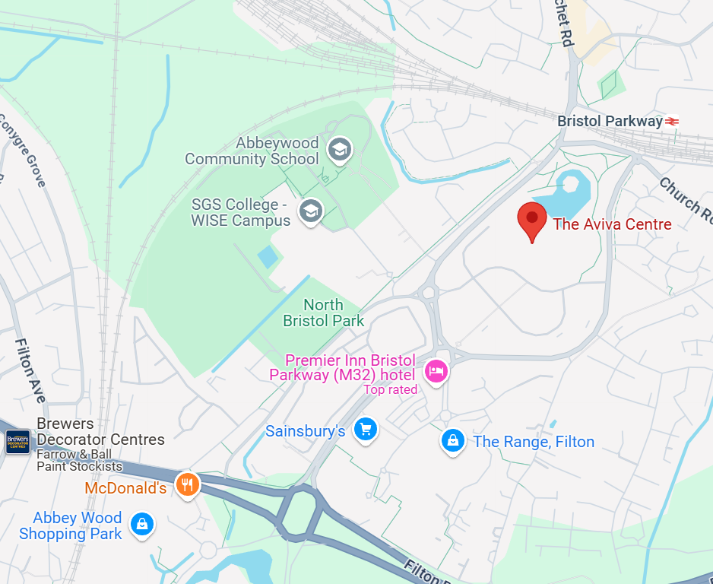
4-Day Onsite Work Experience
Hewlett Packard Enterprise (HPE) are offering students from years 10-12 to attend our work experience opportunity in Bristol.
HPE is a technology company providing solutions to businesses worldwide. We work with companies from DreamWorks and Disney to Mercedes AMG Petronas F1, Red Bull Racing and the NASA Space Station too!
So, whether you love technology or just a bit curious, join our Bristol engineering office for a 4-day work experience to explore what a career in tech looks like.
We are offering 2 work experience events in 2025:
Monday 7th – Thursday 10th April
Monday 14th – Thursday 17th July
Each day in the office will be from 10:00-16:00.
What will I do?
Hear from HPE colleagues from a range of areas across the business about how they got where they are and what a typical day looks like
See first-hand what it's like to work at HPE
Work on a Python programming group project based on data analytics and presenting your work to a wider group
Take part in employability and CV workshops, improving your innovation and presentation skills
Please be aware that we have moved our office to:
The Aviva Centre
Stoke Gifford
BS34 8SW
Scan the QR code to apply

